Slide 1
Media Language
Camera shots

Slide 2
Camera shots - Distances and Angles
Different camera shots are defined by the following criteria:
Distance
Angle
Movement
Look at the following camera shots - each is identified by its distance or angle. (These of course can be combined).

Slide 3
Choosing Camera Shots
A media producer will choose a particular shot depending on the effect they want to convey to the audience.
Distance: The closer we are to the subject, the more detail we can see, and our relationship with the subject is more intense.
Angle: Angles can change the status of the audience in relation to the subject. They can also disrupt the audience.
Look at the following angles and their purpose.

Slide 4
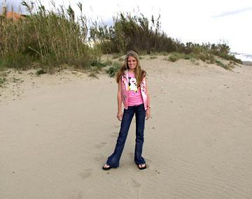
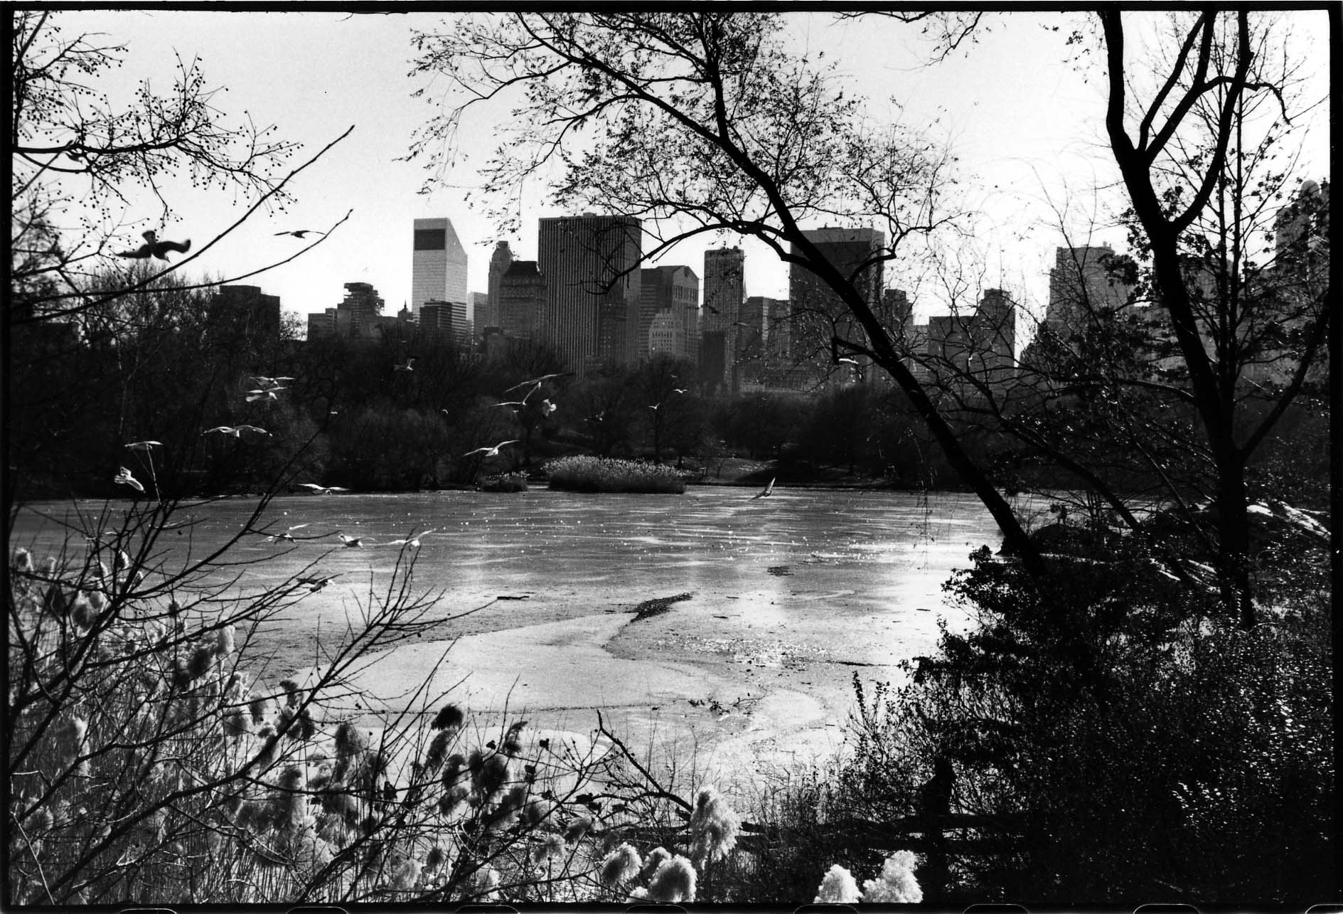
This shot helps us to see everything in the frame. We feel very distant and separate from the subject. It is often used at the beginning of a sequence to let us know where the scene is set.
Extreme Long shot/ Establishing shot
Notes:
Extreme long shot/establishing shot
This shot helps us to see everything in the frame. We feel very distant and separate from the subject. It is often used at the beginning of a sequence to let us know where the scene is set.

Slide 5
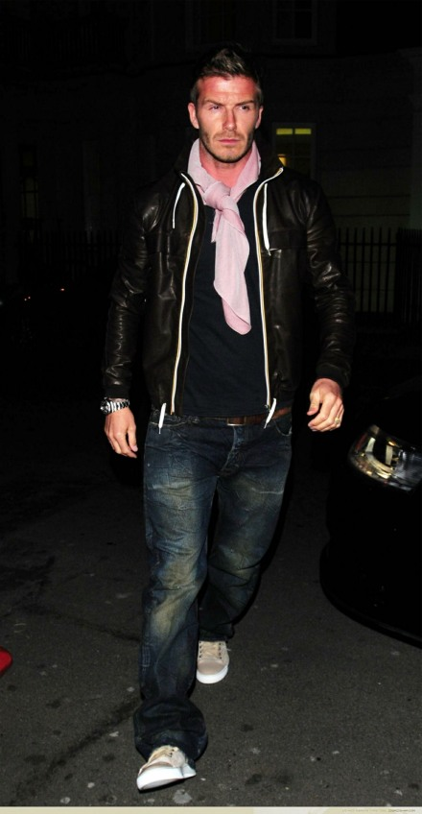
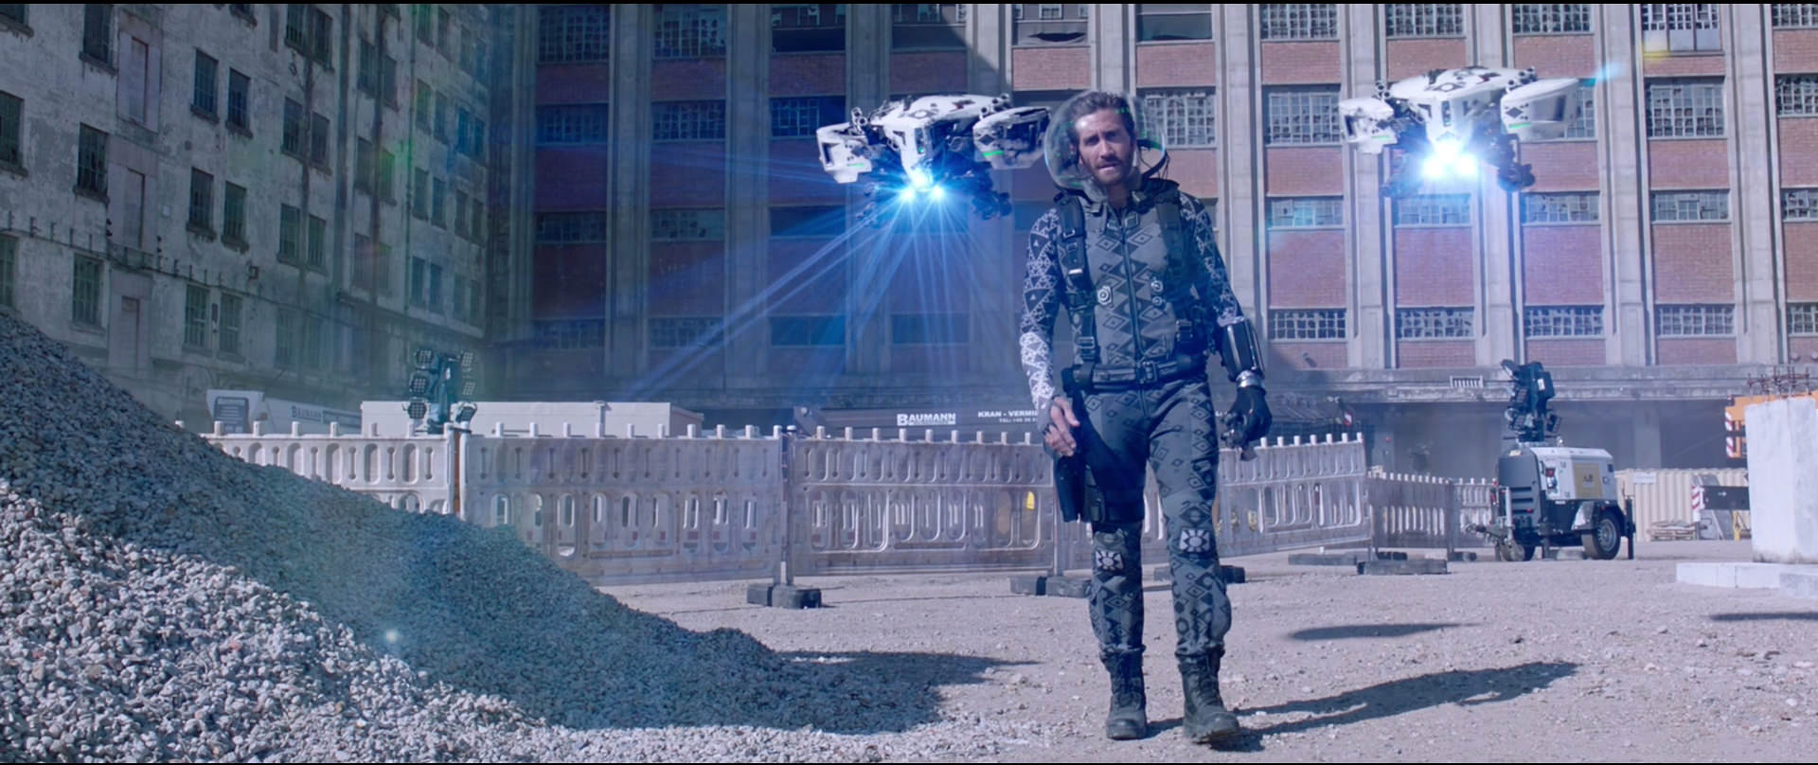
It allows the audience to see all of the subject and some of the background
Long Shot
Notes:
Long shot
The audience feels quite distant from the subject as if they are watching/observing from far away. It allows the audience to see the subject and some of the background

Slide 6
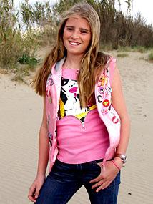
The audience is at a distance from the subject but we can still see features. It allows you to see facial expressions, but also some upper body movement and gesture.
Medium Long Shot

Slide 7
The audience feels close to the subject but can see some of the background which helps to put the subject in a setting/context.
Medium Shot
Notes:
Medium shot
The audience feels close to the subject but can see some of the background which helps to put the subject in a setting/context.

Slide 8
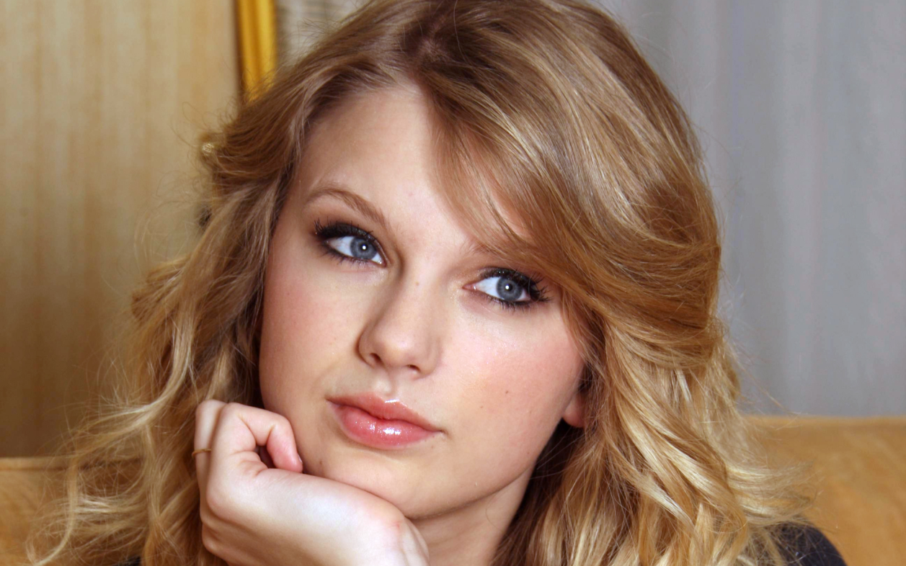
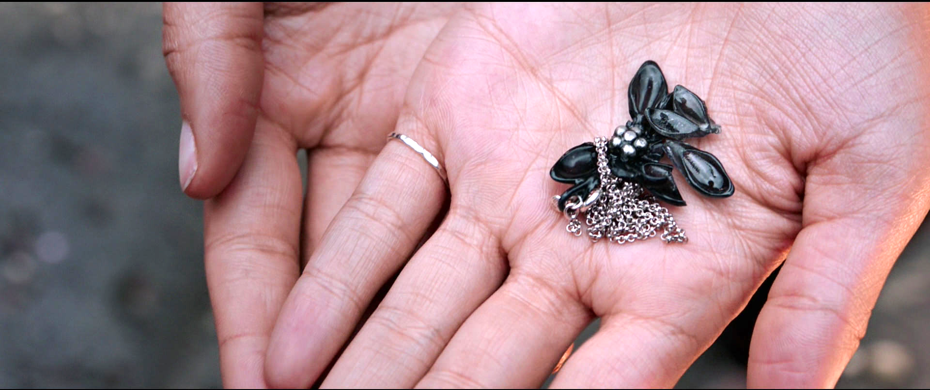
The audience feels close and intimate with the subject. It helps us focus on a person’s thoughts and feelings. It is used to signal that something is important.
Close Up
Notes:
Close up
The audience feels close and intimate with the subject. It helps us focus on a person’s thoughts and feelings or to focus on something important.

Slide 9
The audience feels very close and intimate to the subject. The way the shot is cropped can be used to create an artistic effect.
Big Close Up
Notes:
Big close up
The audience feels very close and intimate to the subject. The way the shot is cropped can be used to create an artistic effect.

Slide 10
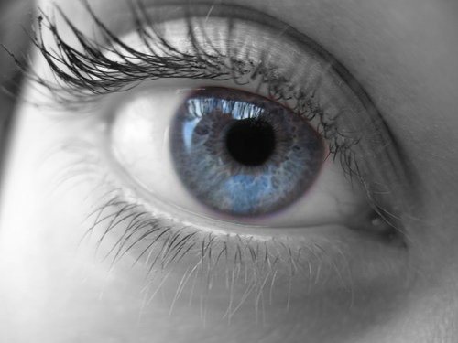
The audience can only focus on one small part of the subject. It is often used to indicate something important. Sometimes - it can make the audience feel trapped or claustrophobic. It can smaller object seem large.
Extreme Close Up
Notes:
Extreme close up
The audience can only focus on one small part of the subject. It is often used to indicate something important. Sometimes - it can make the audience feel trapped or claustrophobic. It can smaller object seem large.

Slide 11
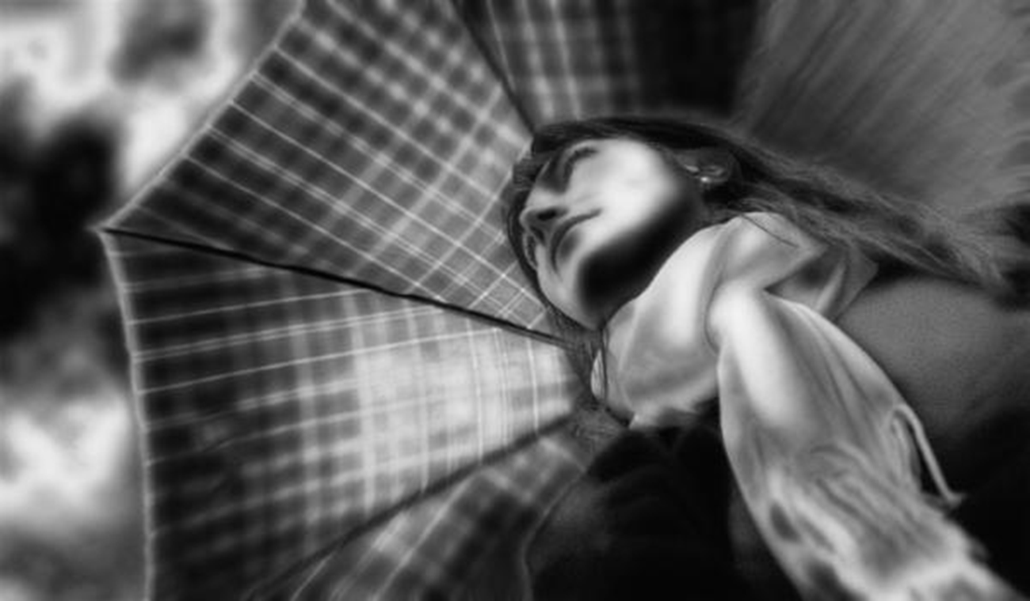
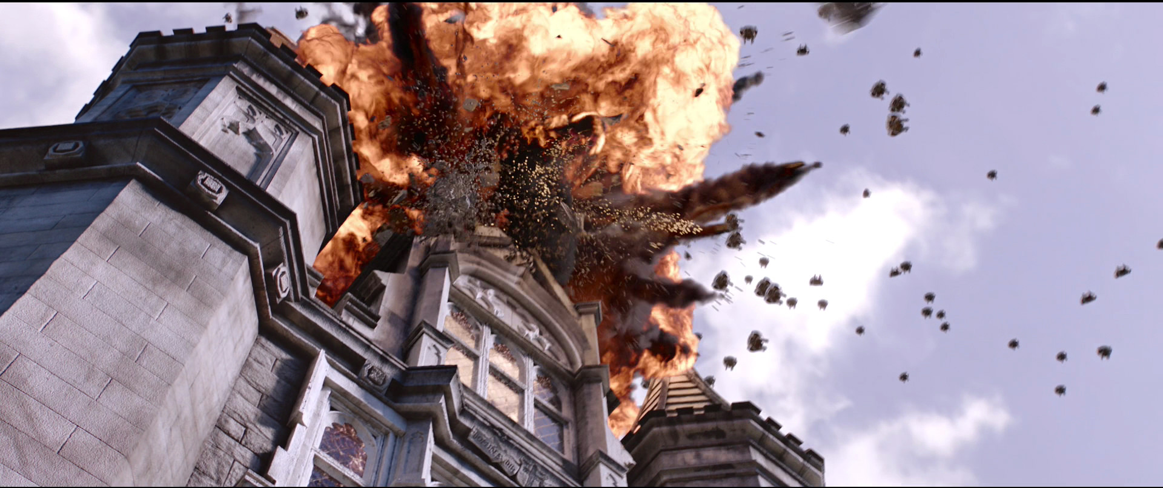
The audience is made to feel small and weak and the subject powerful or formidable. They can sometimes feel threatened or disoriented.
Low Angle/Worm’s Eye
Notes:
Low angle/worm’s eye
The audience is made to feel small and weak. They can sometimes feel threatened. Sometimes it’s just a fun angle

Slide 12
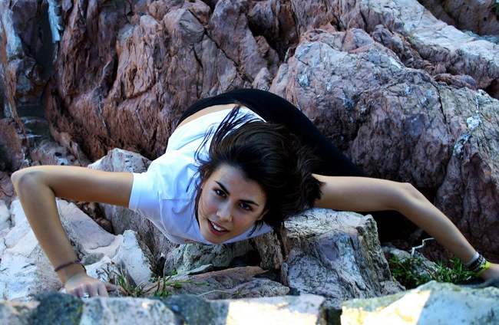
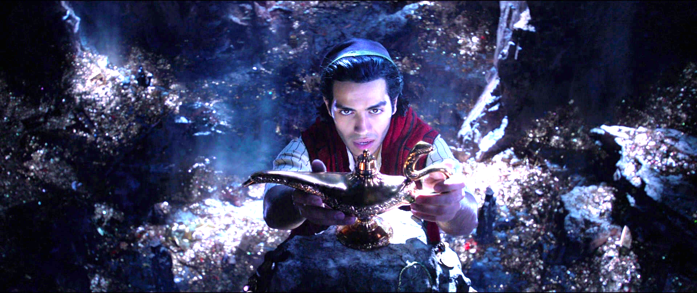
The audience is looking down on the subject, and therefore made to feel more powerful and in a position of dominance.
High Angle/Bird’s Eye

Slide 13
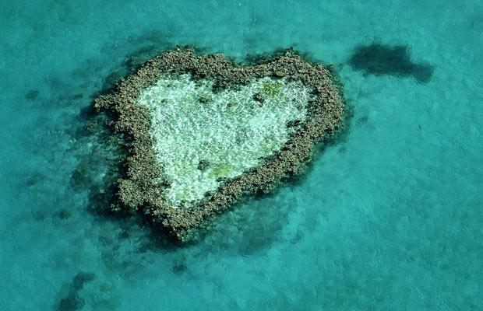
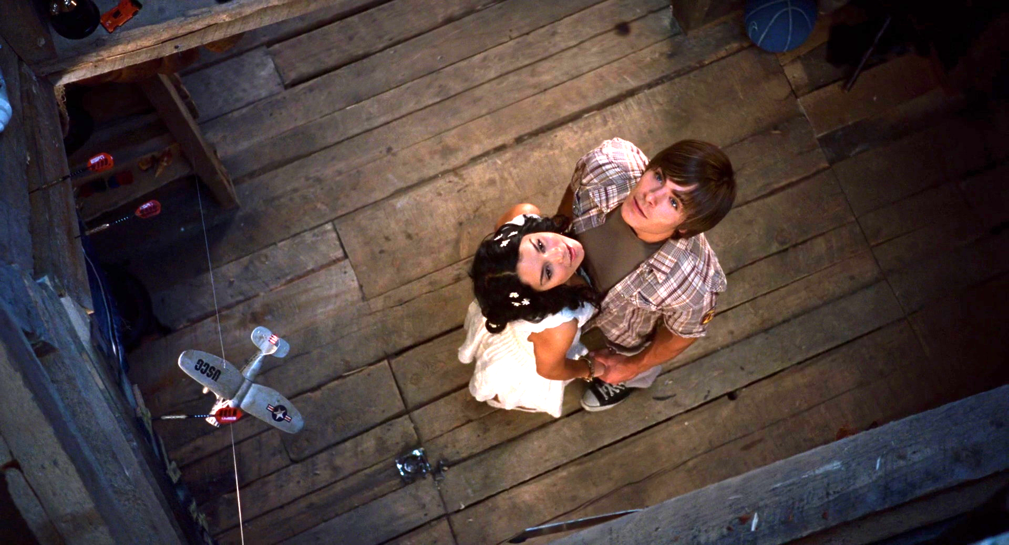
This is a dramatic shot that puts the audience is a very powerful, position (it is sometimes called a god shot). It makes the subject seem small and insignificant. It can also be used to show the scale of a the subject (how big or small it is.)
Aerial Shot

Slide 14
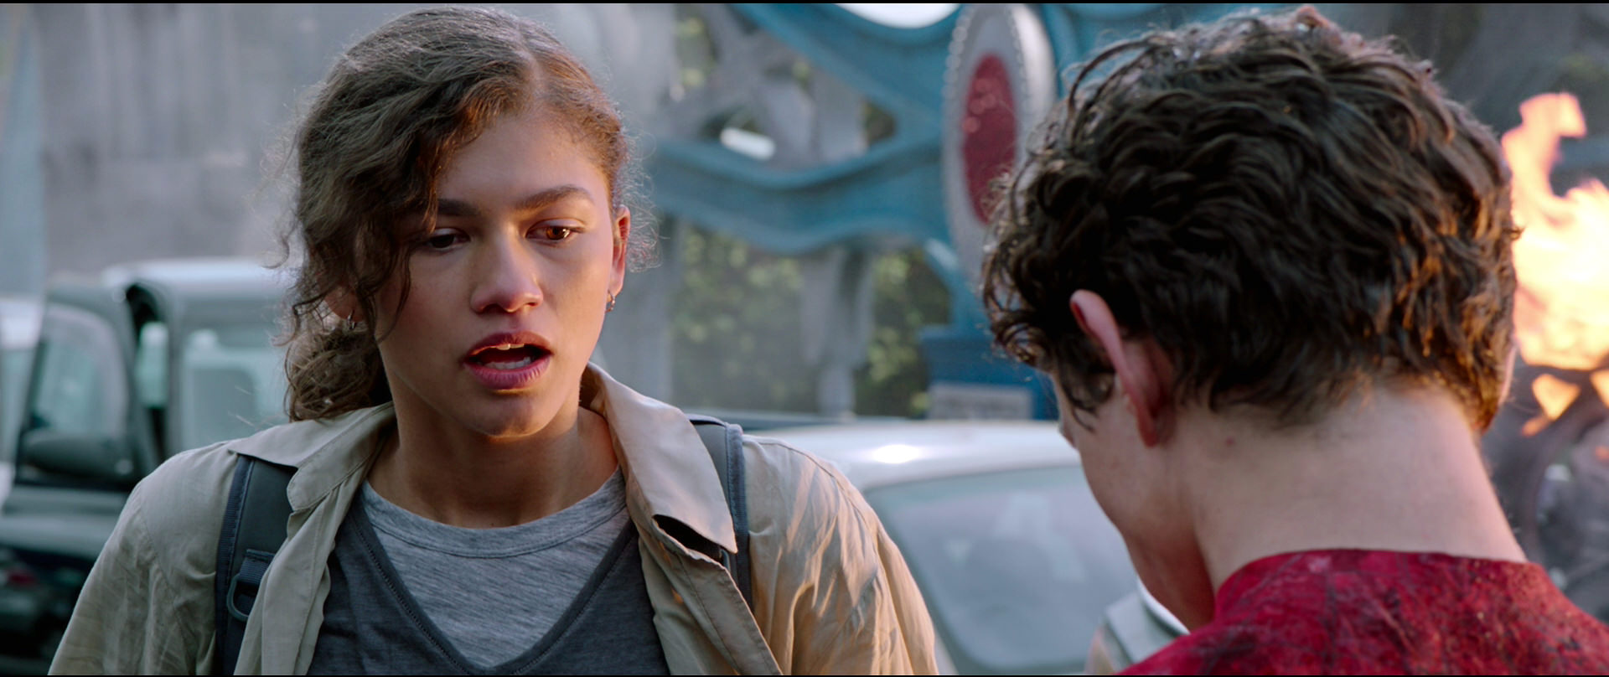
Over the Shoulder Shot (OTS)
This shot is often used in dialogue shots so that we can see both characters but can focus on the face of one of them. It also lets us know how physically close the characters are. Sometimes we feel as if we are in the scene with the characters.
Notes:
Over the shoulder
This shot is often used in dialogue shots so that we can see both characters but can focus on the face of one of them. Sometimes we feel as if we are in the scene with the characters.

Slide 15
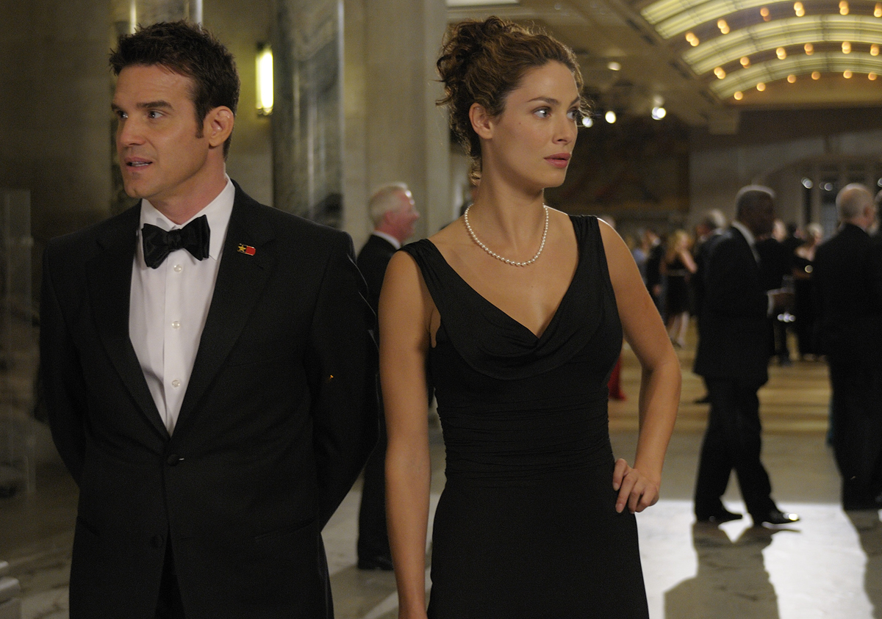
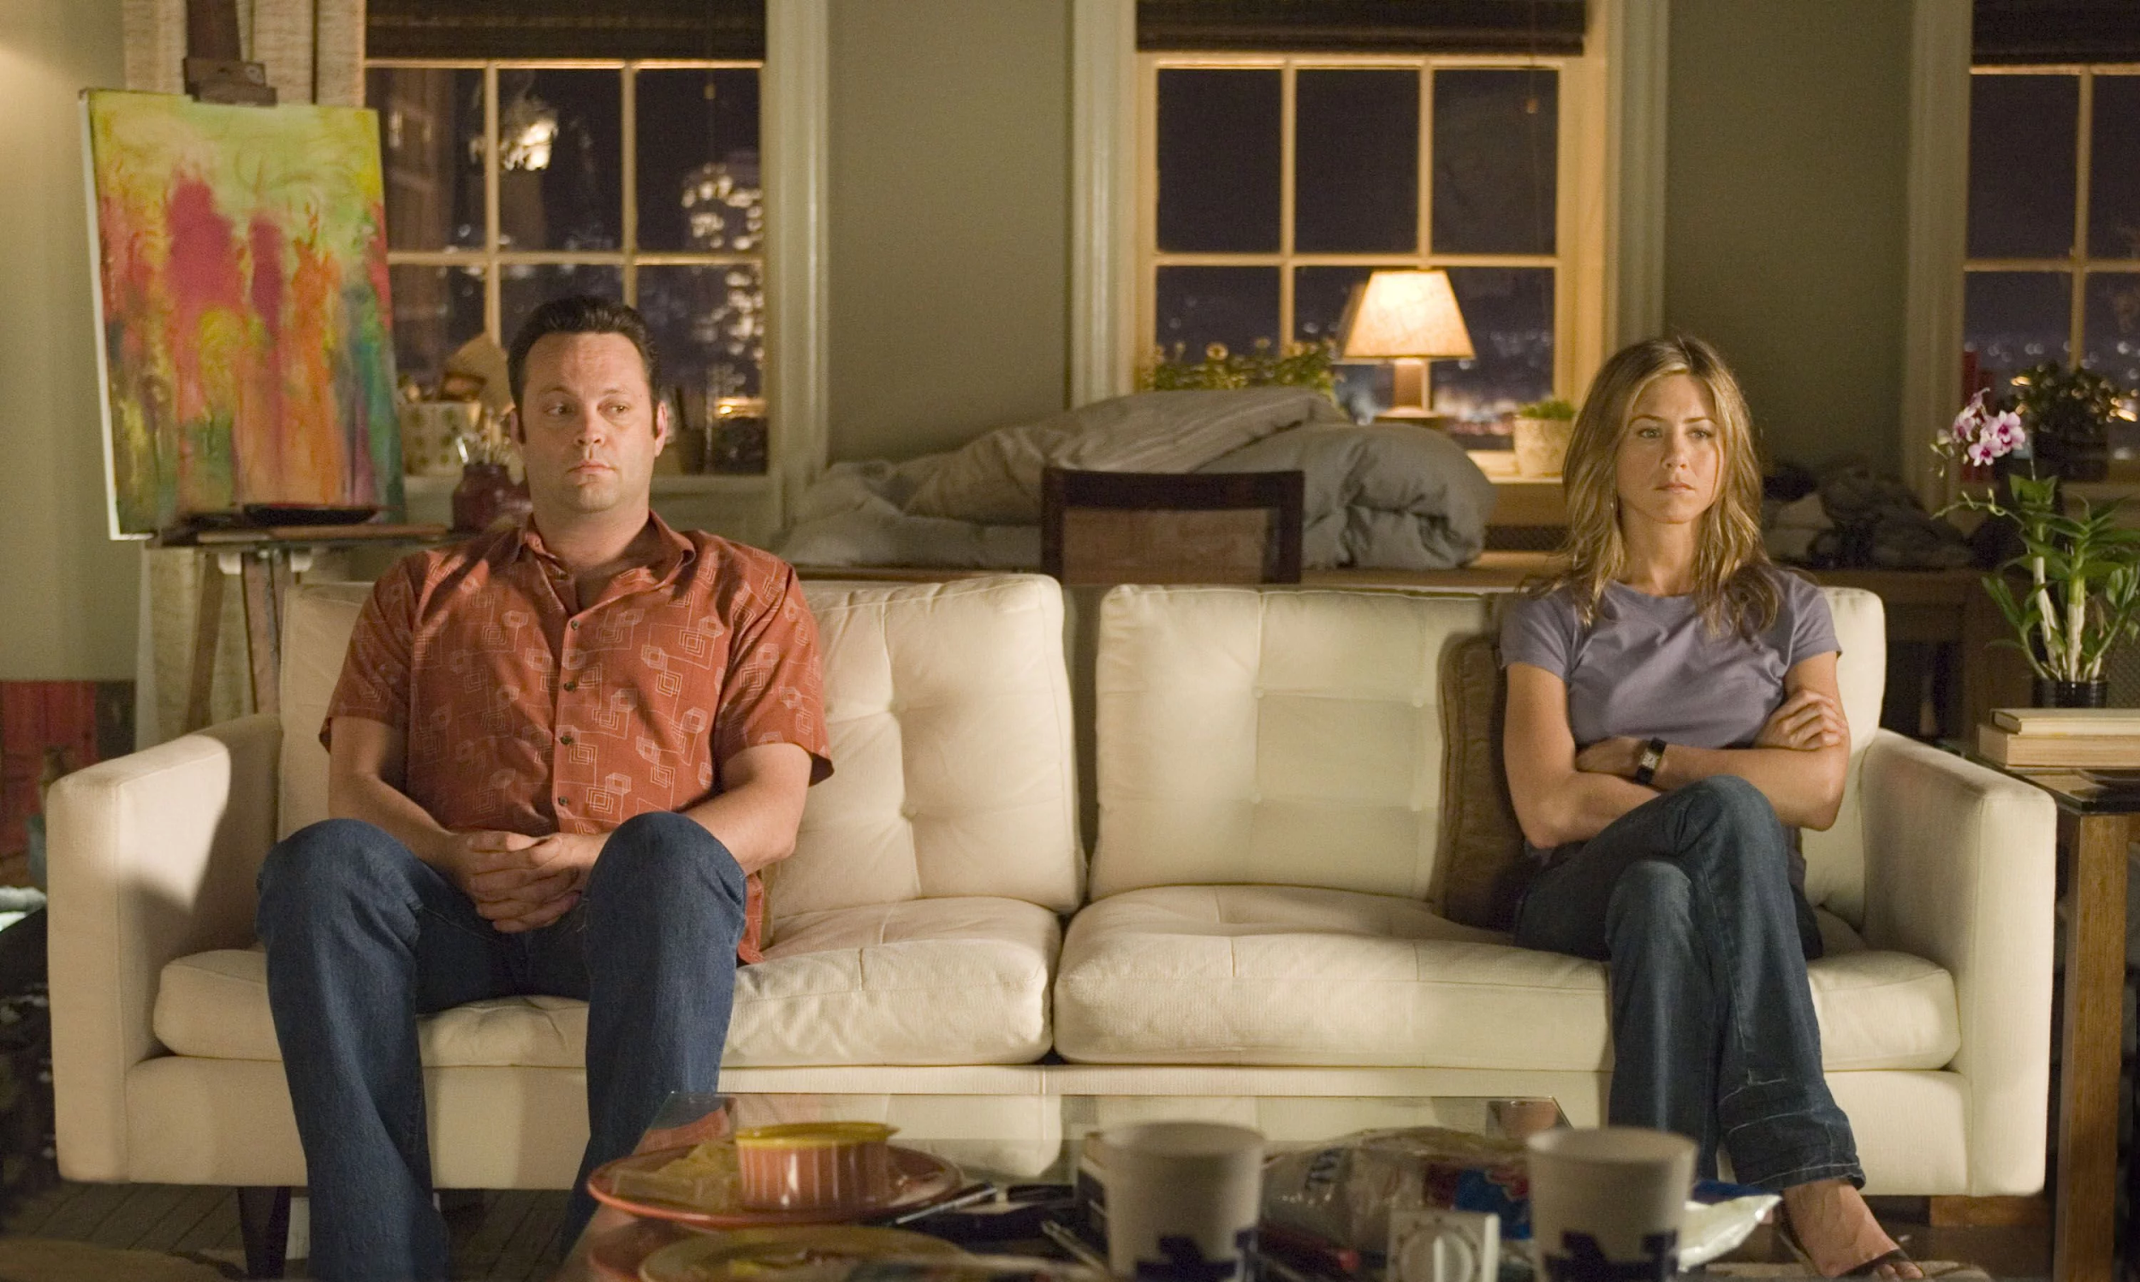
This shots helps the audience to see the relationship between two characters.
Two Shot
Notes:
Two shot
This shots helps the audience to see the relationship between two characters.

Slide 16
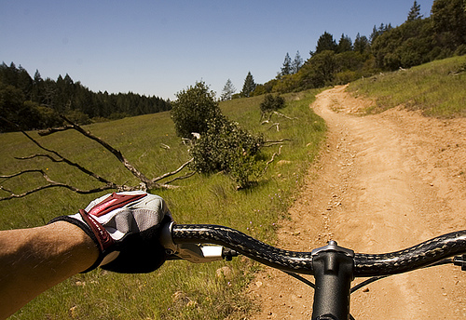
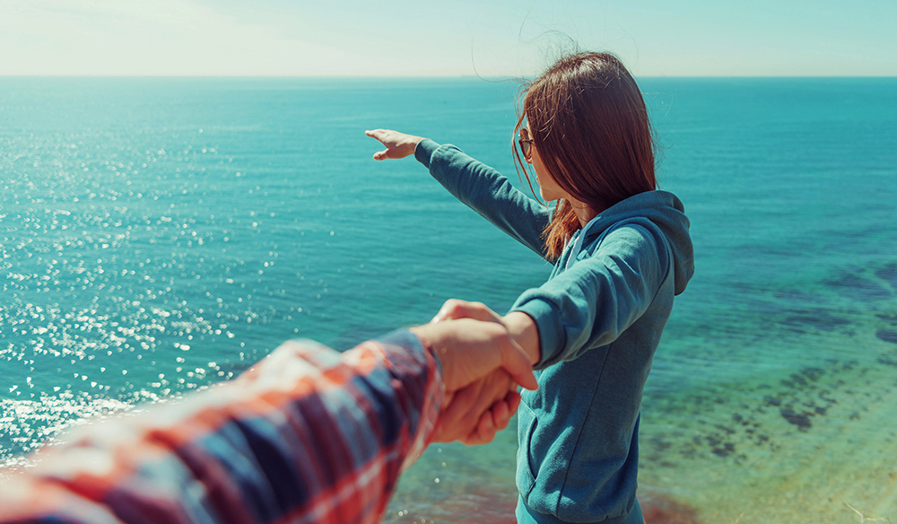
The camera acts as the eyes of the character. It puts the audience right in to the world of the image/film, as if we are there.
Point of View Shot (POV)
Notes:
Point of view shot
The audience is made to feel like a character in the movie. It is very intimate as we become the eyes of the character

Slide 17
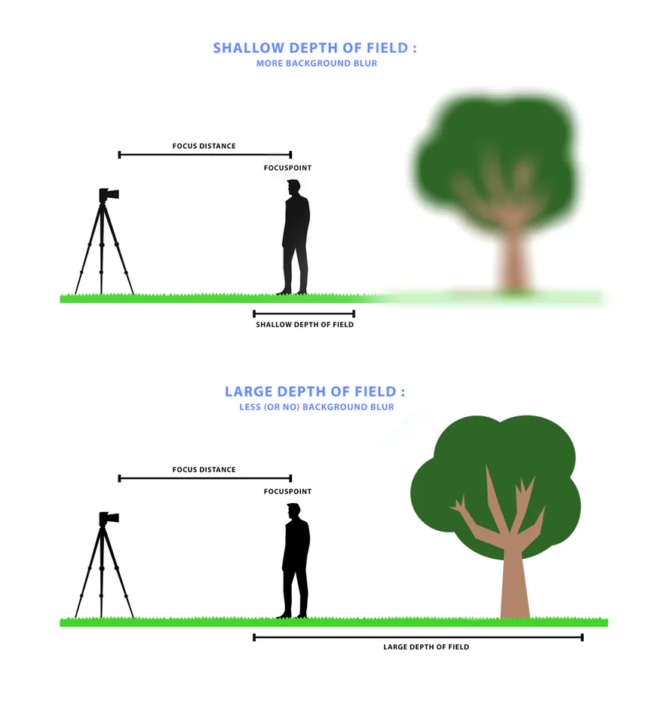
Learning Point: Camera - Depth of Field
Depth of field refers to how far into the distance you can see in a camera shot.
A shallow depth of field means that you can only clearly focus on objects near to the camera (foreground). Background objects appear blurry.
A large depth of field means you can see objects in the distance (background) as well as in the foreground.

Slide 18
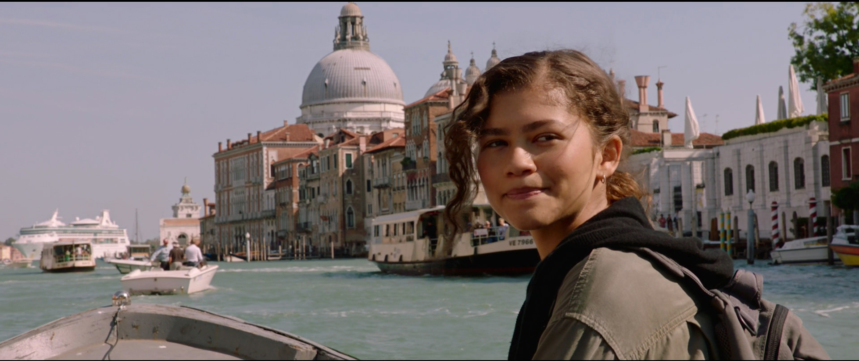
Large Depth of Field

Slide 19
Shallow Depth of Field
The audience is able to focus on an important person or object but still see some of the background and context.

Slide 20
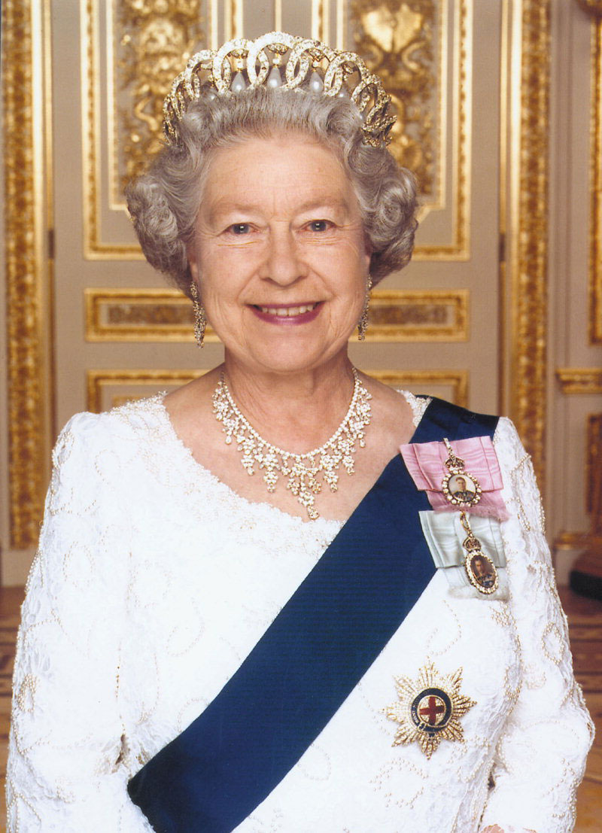
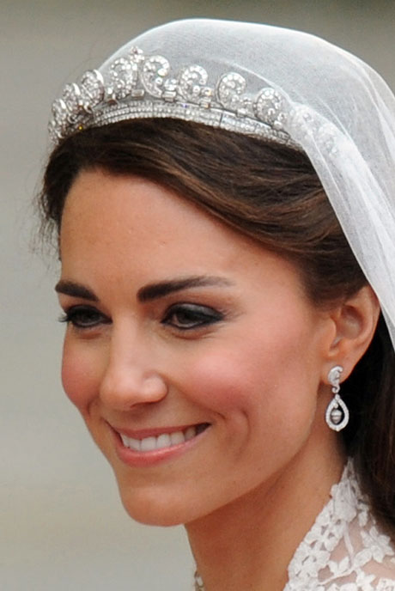
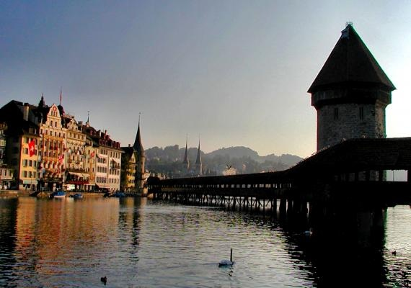
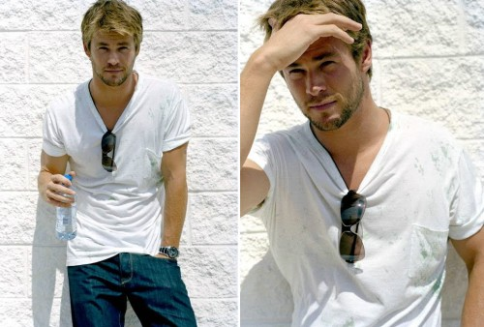
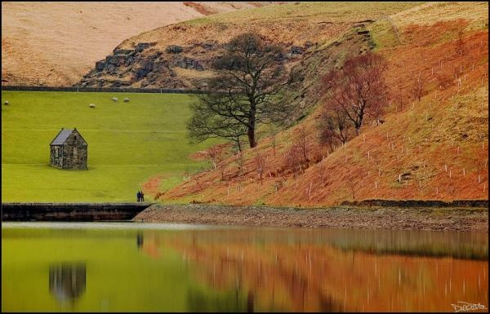
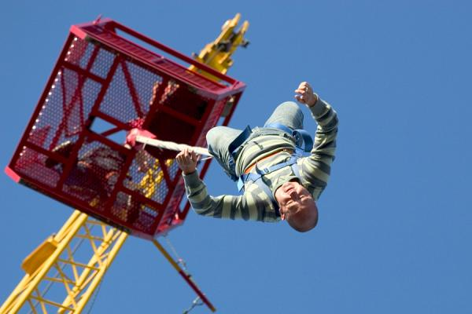
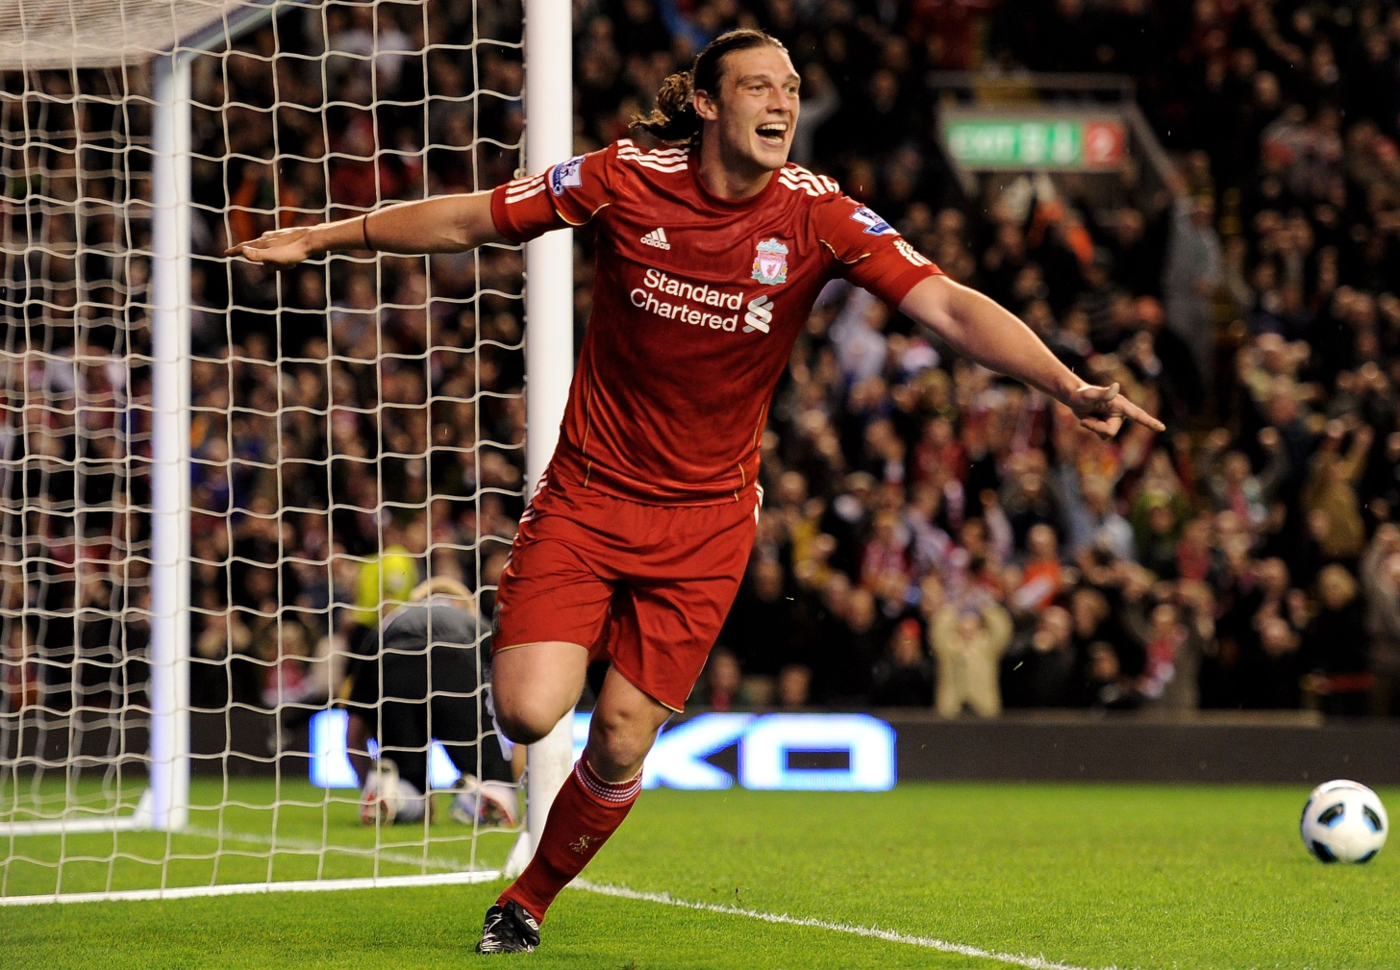
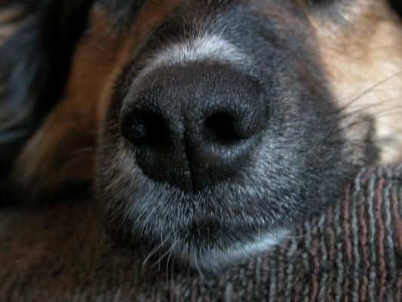
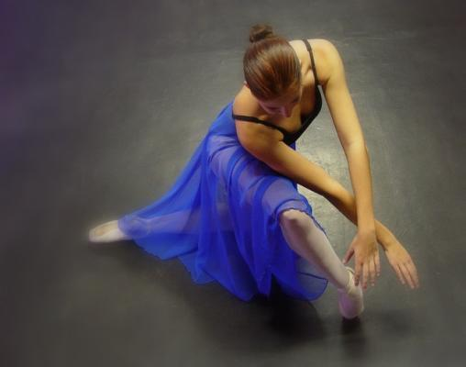
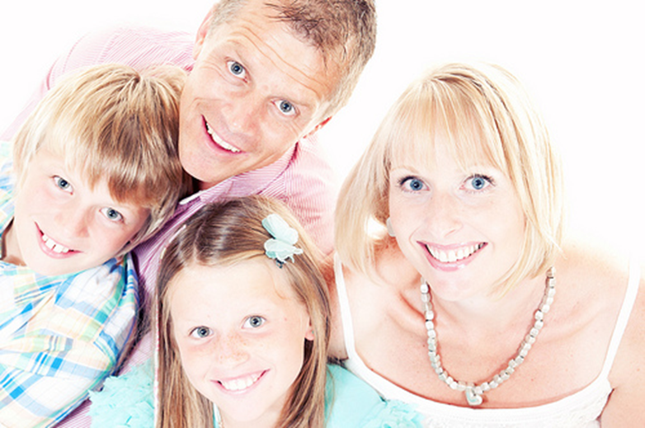
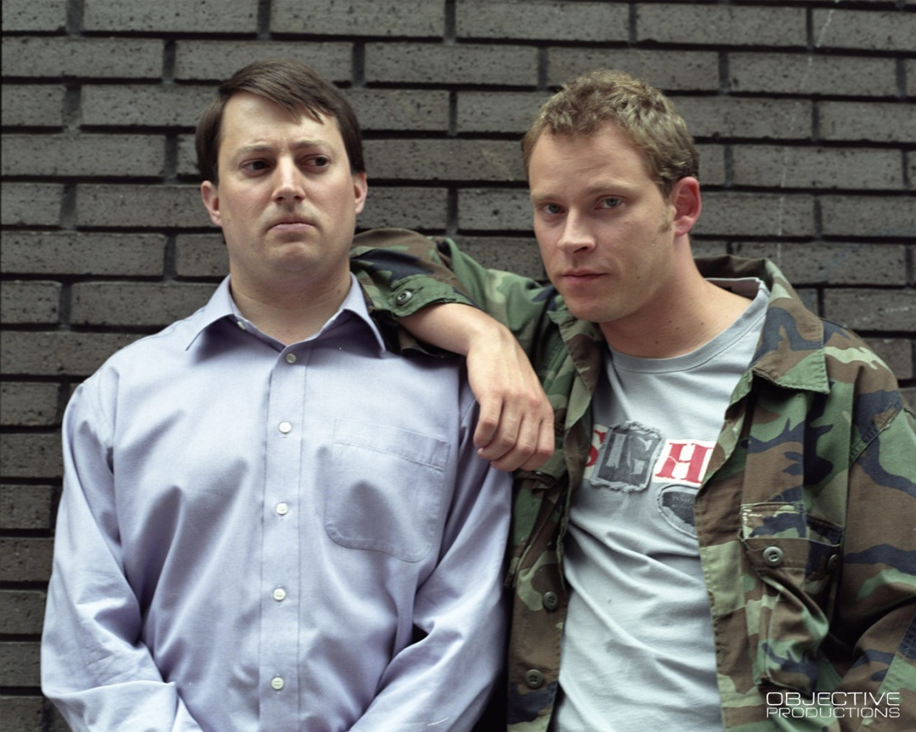
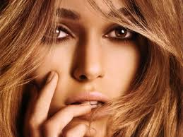
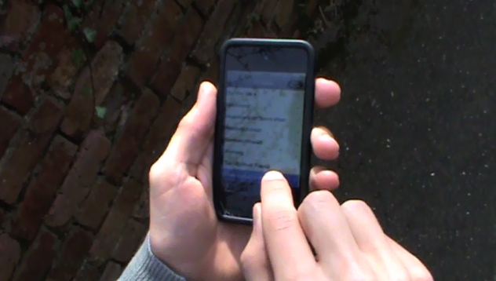
Test Yourself. Play in presentation mode.
Notes:
plenary activity to help students remember the different distance and angle shots – students write answers on mini whiteboards

Slide 21
TASK
Create a presentation:
Find examples of each camera shot, distance and composition and label it with a description of the effect it creates.

