Slide 1
Media Representations
What does this word mean…?
Represent
Media representations is – the way a specific ‘group’ of society is characterised, depicted, portrayed in the media. This includes: gender, age, place and location, ethnicity, issues and nation.
Notes:
Students write ideas on board – copy down

Slide 2
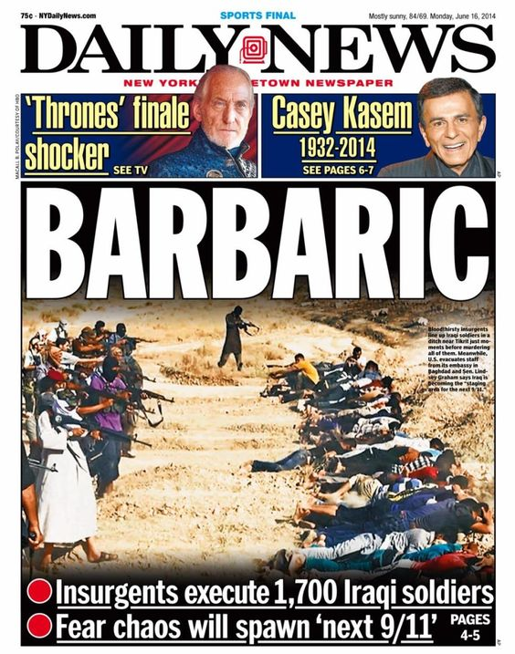
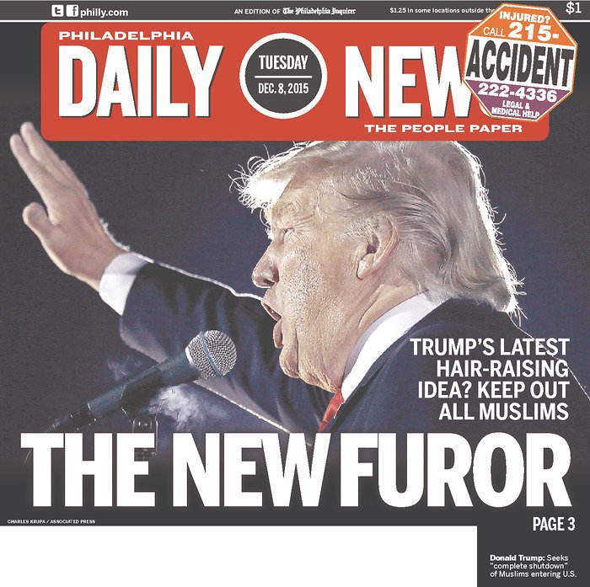
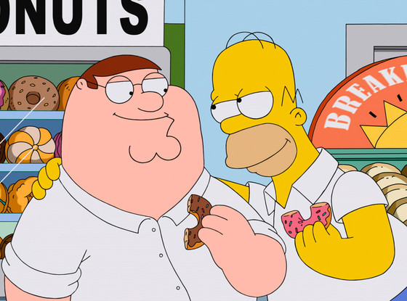
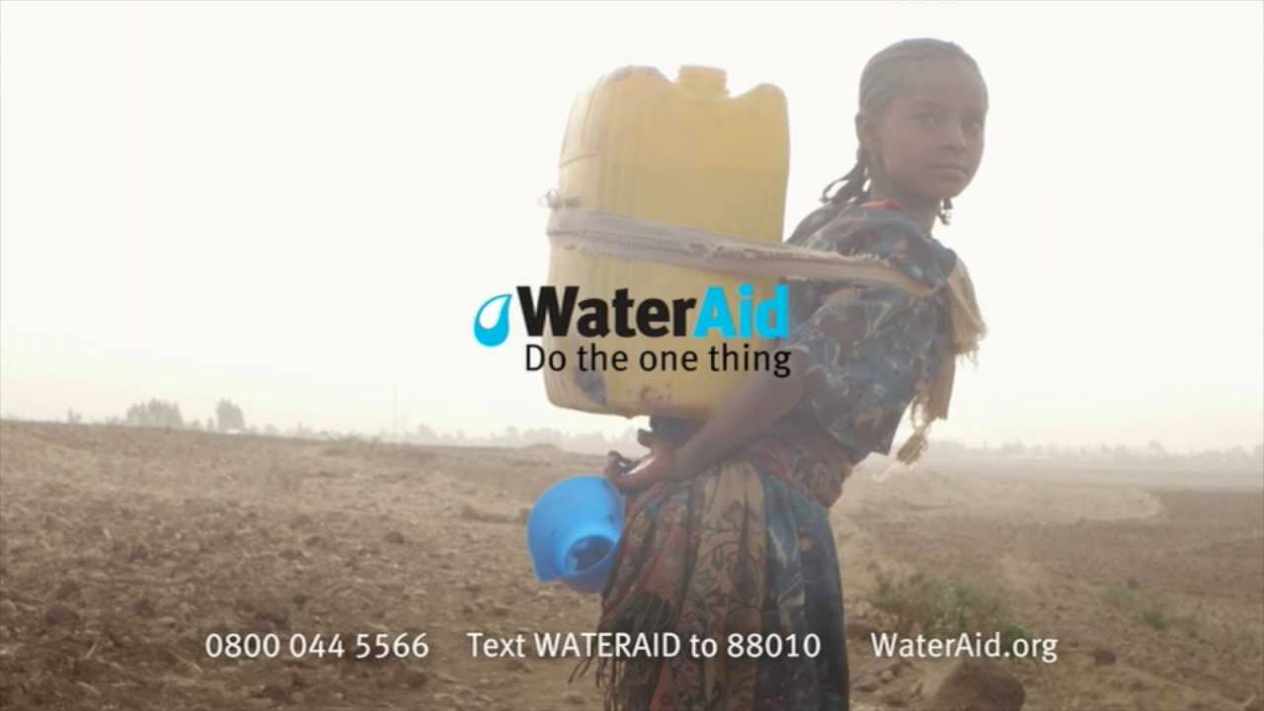
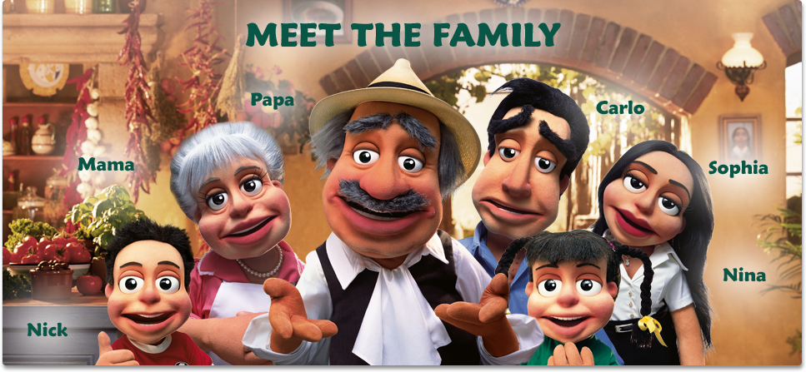
Task: Complete the sheet!
Notes:
Comeplete the sheet – feedback and show these as examples…

Slide 3
Terminology | Definition
Connotation
Stereotype
Archetype
Countertype
Realism
Myth
Cultural Stereotyping | Ideas are created about a specific culture or traditional cultural stereotypes are used.
Mainstream
Marginalization

Slide 4
Media Representations
Label yourself A or B:
Person A: create a mind-map of the stereotypes associated with the British nation.
Person B: create a mind-map of the stereotypes associated with the American nation.

Slide 5
Media Representations
Person A: create a mise-en-scene collage of images that are a visual representation of the British nation.
Person B – create a mise-en-scene collage of images that are a visual representation of the American nation.
You will have to use well know assumptions and stereotypes associated with your Nation to help create you collage. Start by mind-mapping or listing stereotypes.

Slide 6
How is nation represented in The Daily Mail newspaper?
Notes:
An adaptations of SAMS – mark as if Component 1 Sec A question 2b, adapt mark scheme

Slide 7
Representations of America
Alvarado’s Theory of Ethnicity: There are four key way in which race and ethnicity are represented in the Media:
Exotic
Dangerous
Humorous
Pitied.
Write a paragraph:
America is represented as (exotic) according to Alvarado’s theory, this is signified by…
Notes:
Apply to Trumpquake – use media language and images.

Slide 8
How is nation represented in The Daily Mail newspaper?

